Slide 1
Using the jFed tool to experiment from zero to hero
Brecht Vermeulen
FGRE, July 7th, 2015

Slide 2
jFed
Framework for experimenting, monitoring, testing with
GENI racks
Fed4FIRE testbeds
Compatible testbeds in EU, Korea, Brazil, Japan, …
http://jfed.iminds.be

Slide 3
Tutorial
Starting simple
Going to advanced topics but still an easy user interface
Agenda:
Simple two-node experiment with latency
Multi-rack experiment
Upscaling
Short overview of advanced features

Slide 4
Basic experiment

Slide 5
Setup
← 100ms latency
100ms latency →

Slide 6
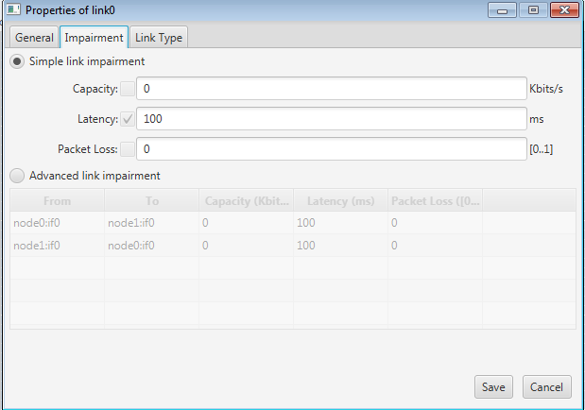
Draw your topology in jFed
Chose the rack that has been assigned to you
Latency configuration

Slide 7
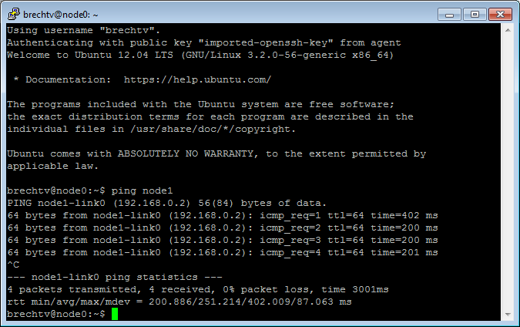
Login and ping

Slide 8
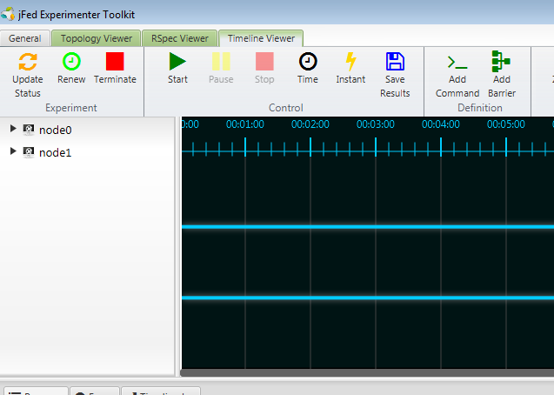
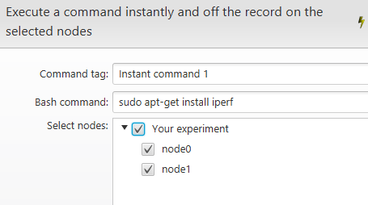
Install iperf on both nodes

Slide 9
Learning more
Go back to the design mode (blue tab), and go to the rspec editor: you can also manually change things, save the RSpec, etc
If you right click a node and configure it, you can also select images
For XEN VMs you can configure RAM, extra disk, routable control IP. Also Exogeni can be selected under virtual machine and configured. (we will not start such an experiment)
Go to the running experiment (bottom green tab), in RSpec view and verify details on nodes, login, RSpec manifest
Information on options for a running node:
Node reload = reload the image for that node (=reformat the node)
Node info = detailed ssh info + interface info
Node reboot = simple reboot of the node
create image = will take an image of your node that you can use in new experiments (we won’t do this now)

Slide 10
Info about the experiment on the node
Geni-get commands
wget http://doc.ilabt.iminds.be/ilabt-documentation/_downloads/geni-get-info.py
chmod u+x geni-get-info.py
./geni-get-info.py

Slide 11
Manage experiments
Verify on geni portal that your experiment is listed and verify the expiration date
Renew in jFed can extend this (for all slivers), or you can renew in the portal
In jFed, you can Edit ssh keys on the nodes if you want to add other users (‘edit ssh keys button’)
If you close jFed, or have created an experiment with another tool, you can ‘recover’ this experiment
In jFed you can share the experiment with other people in your project, to make others member of the slice and be able to recover it in jFed e.g.

Slide 12
Let’s break and reboot
Verify that eth0 is your control interface (where you are logged in)
Turn off: ‘ifconfig eth0 down’, your ssh connection will be lost
The next steps might not work for everyone, but you can try them:
Now, in jFed right click the node and click reboot
Right click and ‘show console’ to show you how it boots
After that you can access the node again

Slide 13
Terminate your experiment
That was your first experiment
If anything goes wrong, push bugreport button

Slide 14
Multi-rack experiment

Slide 15
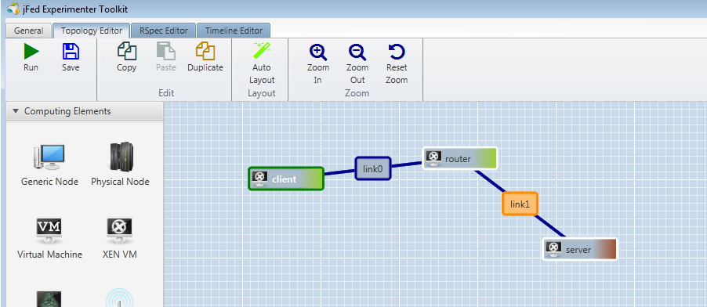
Topology
192.168.0.2
192.168.1.2
192.168.0.1
192.168.1.1
RACK 1
RACK 2
Route add –net 192.168.1.0/24 gw 192.168.0.2

Slide 16
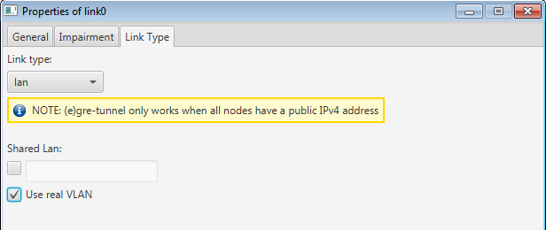
ATTENTION: LINK IN RACK 1

Slide 17
Upscale

Slide 18
Topology
192.168.0.2
192.168.1.2
192.168.0.1
192.168.1.1
RACK 1
RACK 2
Route add –net 192.168.1.0/24 gw 192.168.0.2

Slide 19
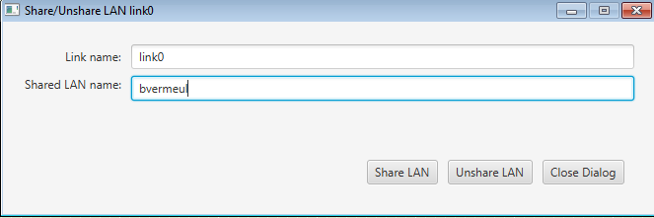
Share the VLAN on client side
Right click green link
Chose unique name

Slide 20
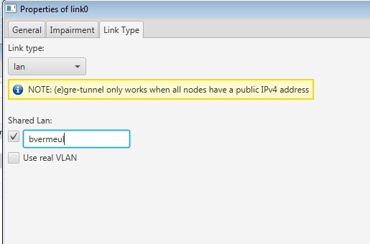
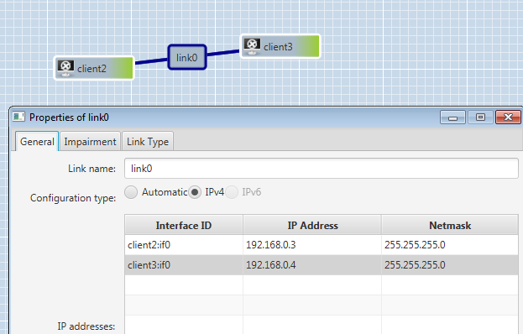
Define new experiment
Configure proper IP addresses
Configure shared lan name

Slide 21
Verify that it pings and routes

Slide 22
Upscale further ?
Use the duplicate button in jFed
Use bash scripting to create RSpecs
Use geni-lib to make upscaled RSpecs

Slide 23
Connectivity: proxy

Slide 24
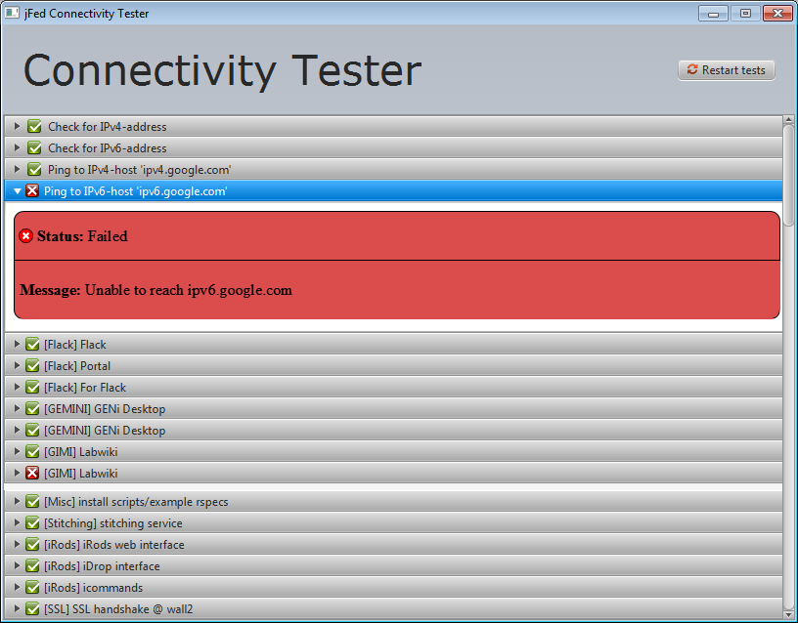
Connectivity test (also in bug report)

Slide 25
TCP ports and firewalls
12369, 12346, 11443, 8081, …
IPv6 for node access
= problems
First step: Detection (connectivity tester)
Second step: work around -> SSH proxy

Slide 26
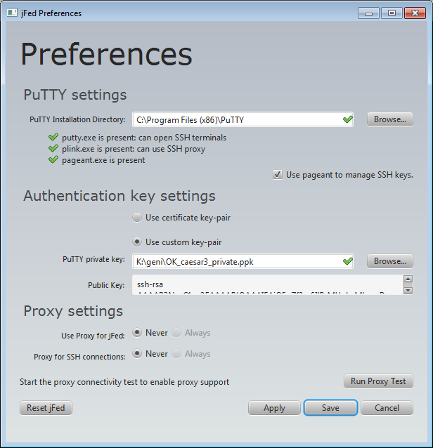
SSH proxy (optional !)
For API calls
For SSH login
Automatic SSH agent for extra comfort

Slide 27
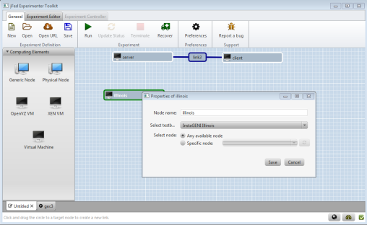
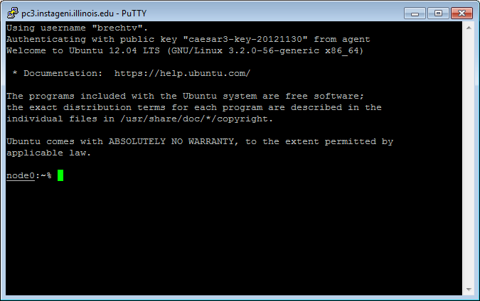
SSH proxy: only TCP 22
Virtual Wall Authority
IPv4
API calls
TCP 22
IPv4 SSH
TCP 22
Public SSH keys
of PEM cert
SSH gateway server
AMs, nodes, …
IPv4/IPv6
API calls
SSH login
Even private vpns connected to SSH gateway

Slide 28
International federation and connectivity

Slide 29
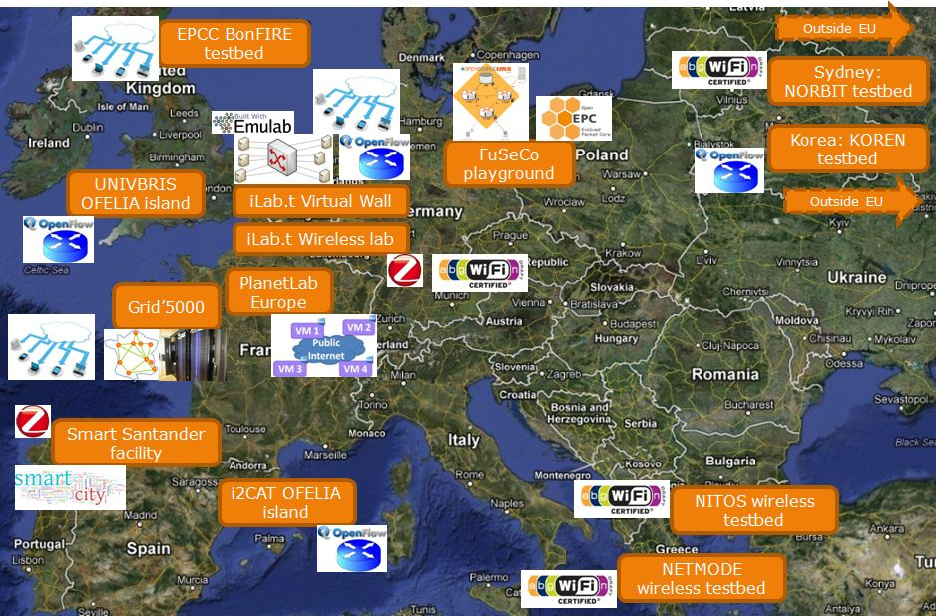
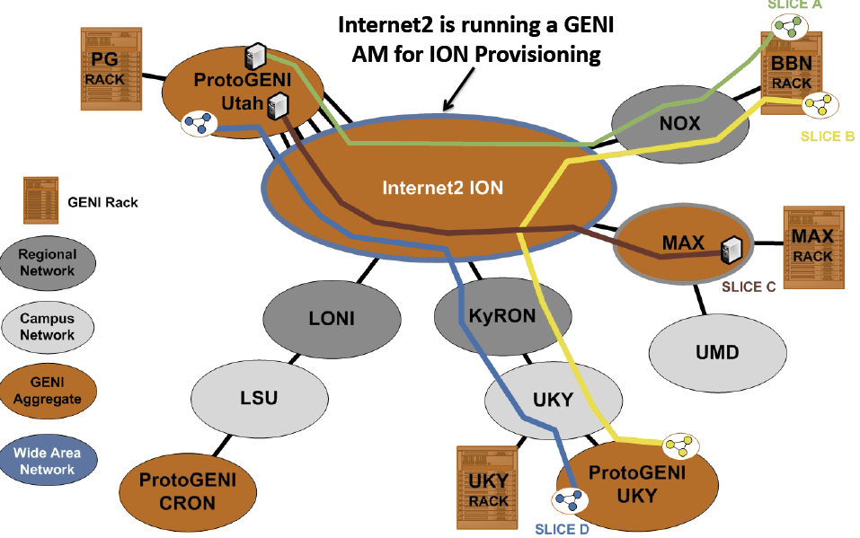
Layer 2 connectivity = stitching VLANs
AUTOBAHN
SDX
STATIC
VLANS
Meshed L2 connections possible
SDX = software defined exchange
eases connectivity (=exchange)
VLAN translation needed + SDN functionality

Slide 30
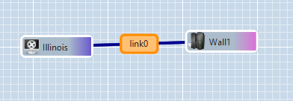
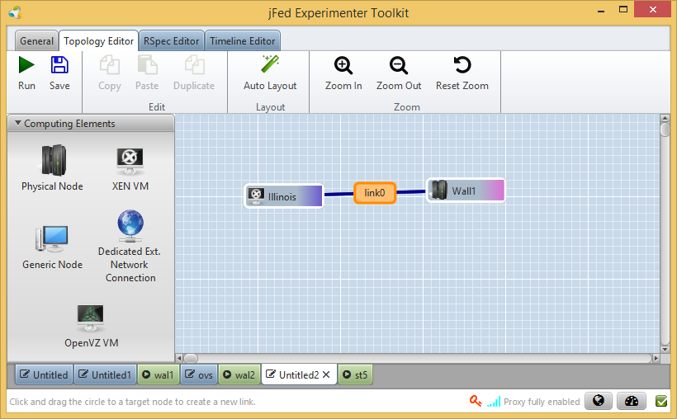
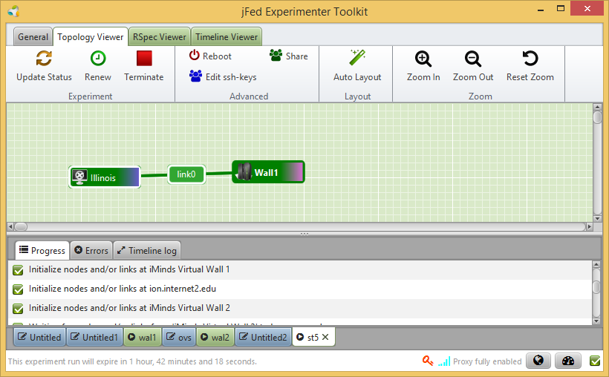
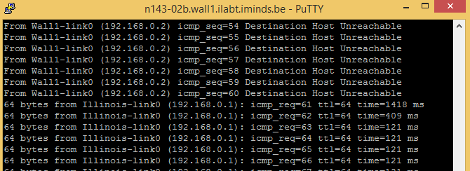
Stitching workflow: iMinds to Illinois
1. Experimenter draws layer 2 link
Stitching Computation Service (SCS)
3. Tool contacts SCS
to know the path
and SCS sends back the path and workflow
(e.g. some networks can do VLAN translation)
2. and starts provisioning
Wall1
Wall2
Geant
Internet2
Illinois
4. Tool provisions at all testbeds and networks
through the aggregate manager API
and negotiates the VLAN IDs
Wall1
Wall2
Geant
Internet2
Illinois
5. User logs in
and can ping

Slide 31
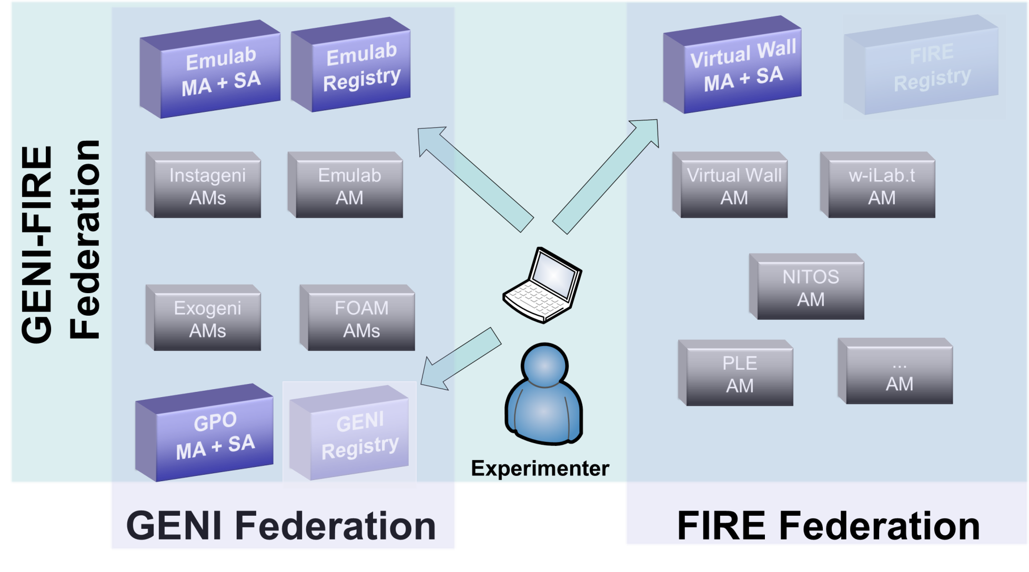
SCS per federation
SCS
SCS
SCS

Slide 32
Preferences overview
Ssh authentication: add your own key
Proxy: in case of firewall problems or to access IPv6 nodes
Configure SCS
Testbed settings: exosm setting to chose the central exogeni broker or go to the specific rack controllers
Ssh agent forwarding to login from node to node automatically: login on a node, and then ssh to another IP address in your topology

Slide 33
Thanks for your attention !
http://jfed.iminds.be
Brecht.vermeulen@iminds.be
jfed-bugreports@intec.ugent.be

